Slide 1
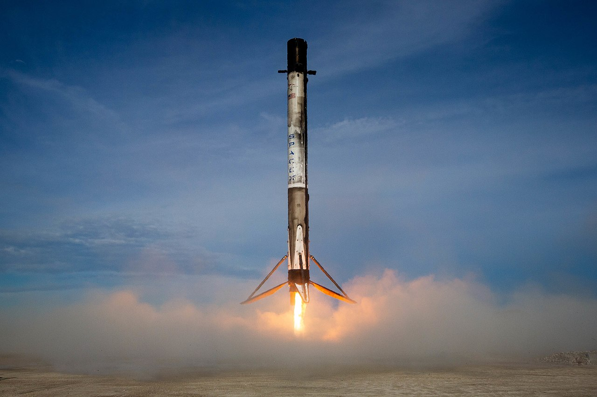
Applied Data Science Capstone
Baran Ağırbaş
May 7,2023

Slide 2
OUTLINE
Executive Summary
Introduction
Methodology
Results
Discussion
Conclusion

Slide 3
Executive Summary
In this latest project, it will be predicted whether the first stage of SpaceX Falcon 9 will land successfully using several machine learning classification algorithms.
The main steps in this project include:
Data collection, discussion and formatting
Exploratory data analysis
Interactive data visualization
Machine learning prediction
The graphs show that some features of rocket launches are related to the outcome of the launches, namely success or failure.
It was also concluded that the decision tree may be the best machine learning algorithm to predict whether the first stage of Falcon 9 will land successfully.

Slide 4
Introduction
This model will predict whether the first stage of Falcon 9 will land successfully. SpaceX advertises Falcon 9 rocket launches costing $62 million on its website; other providers cost more than $165 million each, most of the savings being SpaceX's ability to reuse the first stage. Therefore, if it can be determined whether the first stage will land or not, the cost of the launch can also be determined. This information can be used if an alternative company wants to bid against SpaceX for a rocket launch.
Most failed landings are planned, and sometimes SpaceX makes a controlled landing in the ocean.
The main question that is being tried to be answered is the payload mass, trajectory type, launch location, etc. associated with a Falcon 9 rocket launch. For a given set of features including, will the first stage of the rocket land successfully?

Slide 5
Methodology
The overall methodology includes:
Data collection, wrangling, and formatting, using:
SpaceX API
Web scraping
Exploratory data analysis (EDA), using:
Pandas and NumPy
SQL
Data visualization, using:
Matplotlib and Seaborn
Folium
Dash
Machine learning prediction, using
Logistic Regression
Support Vector Machine (SVM)
Decision Tree
K-nearest Neighbors (KNN)

Slide 6
Methodology
SpaceX API
The API used is https://api.spacexdata.com/v4/rockets/.
The API provides data about many types of rocket launches done by SpaceX, the data is therefore filtered to include only Falcon 9 launches.
Every missing value in the data is replaced the mean the column that the missing value belongs to.
We end up with 90 rows or instances and 17 columns or features.

Slide 7
Methodology
Web scraping
The data is scraped from https://en.wikipedia.org/w/index.php?title=List_of_Falcon_9_and_Falcon_Heavy_launches&oldid=1027686922
The website contains only the data about Falcon 9 launches.
We end up with 121 rows or instances and 11 columns or features.

Slide 8
Methodology
The data is later processed so that there are no missing entries and categorical features are encoded using one-hot encoding.
An extra column called ‘Class’ is also added to the data frame. The column ‘Class’ contains 0 if a given launch is failed and 1 if it is successful.
In the end, we end up with 90 rows or instances and 83 columns or features.

Slide 9
Methodology
Pandas and NumPy
Functions from the Pandas and NumPy libraries are used to derive basic information about the data collected, which includes:
The number of launches on each launch site
The number of occurrence of each orbit
The number and occurrence of each mission outcome
SQL
The data is queried using SQL to answer several questions about the data such as:
The names of the unique launch sites in the space mission
The total payload mass carried by boosters launched by NASA (CRS)
The average payload mass carried by booster version F9 v1.1

Slide 10
Methodology
Matplotlib and Seaborn
Functions from the Matplotlib and Seaborn libraries are used to visualize the data through scatterplots, bar charts, and line charts.
The plots and charts are used to understand more about the relationships between several features, such as:
The relationship between flight number and launch site
The relationship between payload mass and launch site
The relationship between success rate and orbit type
Folium
Functions from the Folium libraries are used to visualize the data through interactive maps.
The Folium library is used to:
Mark all launch sites on a map
Mark the succeeded launches and failed launches for each site on the map
Mark the distances between a launch site to its proximities such as the nearest city, railway, or highway

Slide 11
Methodology
Dash
Functions from Dash are used to generate an interactive site where we can toggle the input using a dropdown menu and a range slider.
Using a pie chart and a scatterplot, the interactive site shows:
The total success launches from each launch site
The correlation between payload mass and mission outcome (success or failure) for each launch site

Slide 12
Methodology
Functions from the Scikit-learn library are used to create our machine learning models.
The machine learning prediction phase include the following steps:
Standardizing the data
Splitting the data into training and test data
Creating machine learning models, which include:
Logistic Regression
Support Vector Machine (SVM)
Decision tree
K nearest Neighbors (KNN)
Fit the models on the training set
Find the best combination of hyperparameters for each model
Evaluate the models based on their accuracy scores and confusion matrix

Slide 13
Results
The results are split into 5 sections:
SQL (EDA with SQL)
Matplotlib and Seaborn (EDA with Visualization)
Folium
Dash
Predictive Analysis
In all of the graphs that follow, class 0 represents a failed launch outcome while class 1 represents a successful launch outcome.

Slide 14
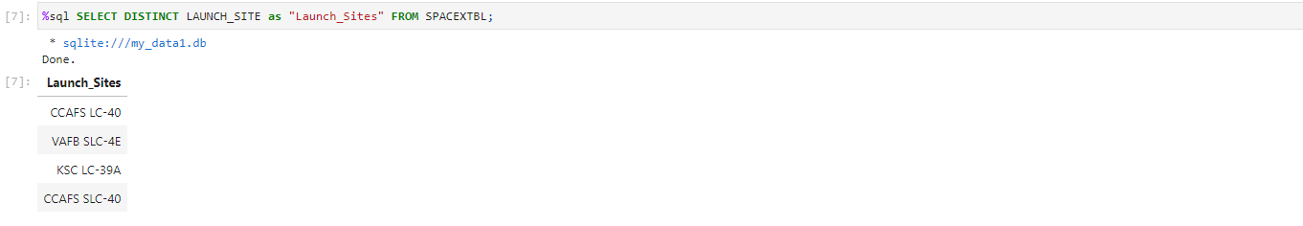
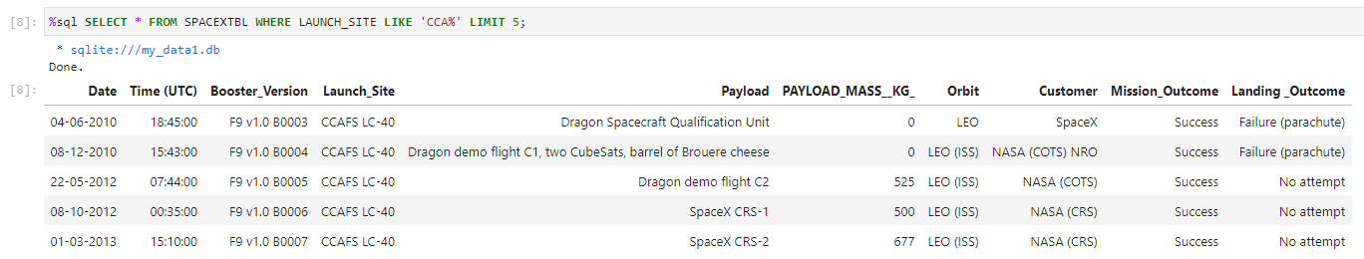
Results - SQL
The names of the unique launch sites in the space mission
5 records where launch sites begin with ‘CCA’

Slide 15
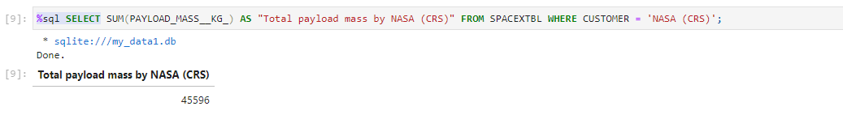
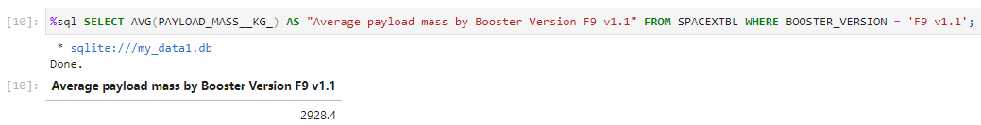
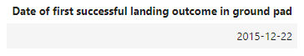
Results - SQL
The total payload mass carried by boosters launched by NASA (CRS)
The average payload mass carried by booster version F9 v1.1
The date when the first successful landing outcome in ground pad was achieved

Slide 16
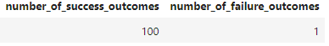
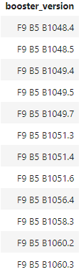
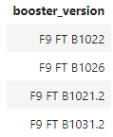
Results - SQL
The names of the boosters which have success in drone ship and have payload mass greater than 4000 but less than 6000
The total number of successful and failure mission outcomes
The names of the booster versions which have carried the maximum payload mass

Slide 17
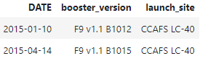
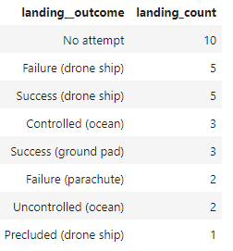
Results - SQL
The failed landing outcomes in drone ship, their booster versions, and launch site names for in year 2015
The count of landing outcomes between the date 2010-06-04 and 2017-03-20, in descending order

Slide 18
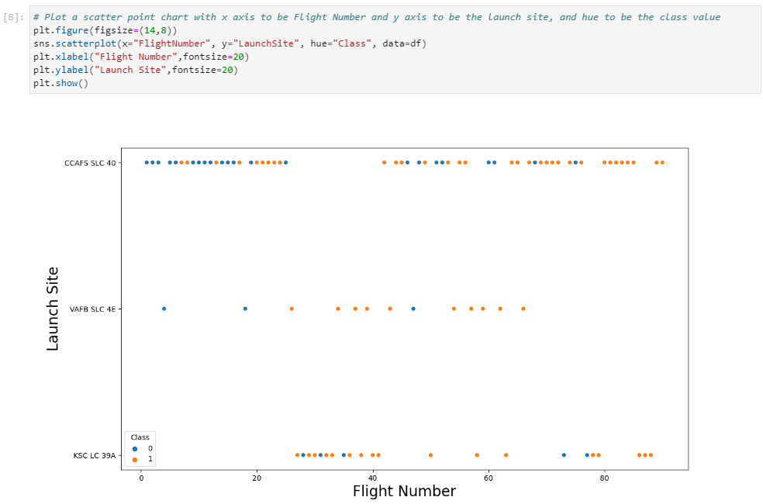
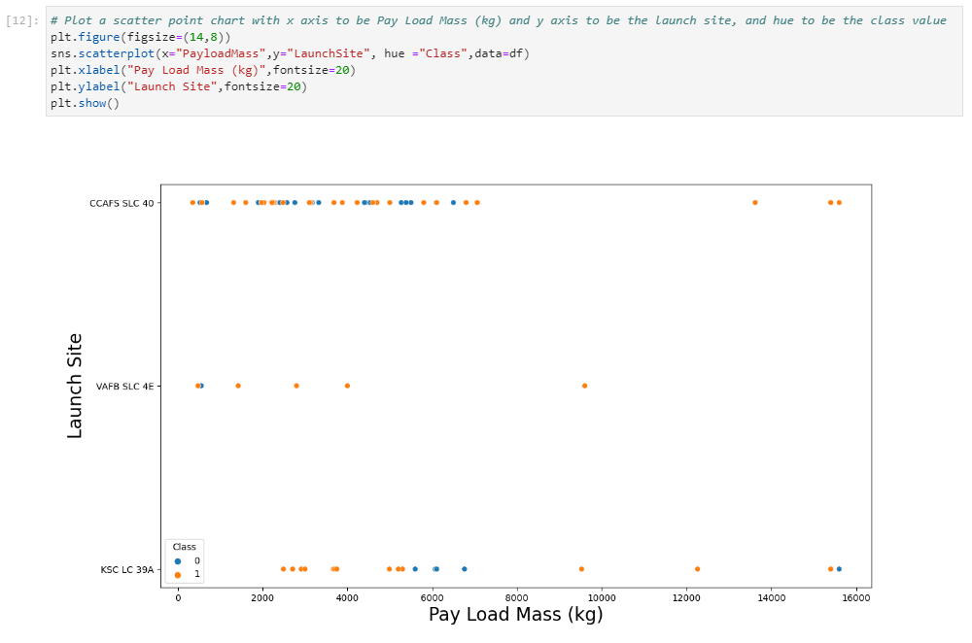
Results – Matplotlib and Seaborn
The relationship between flight number and launch site
The relationship between payload mass and launch site

Slide 19
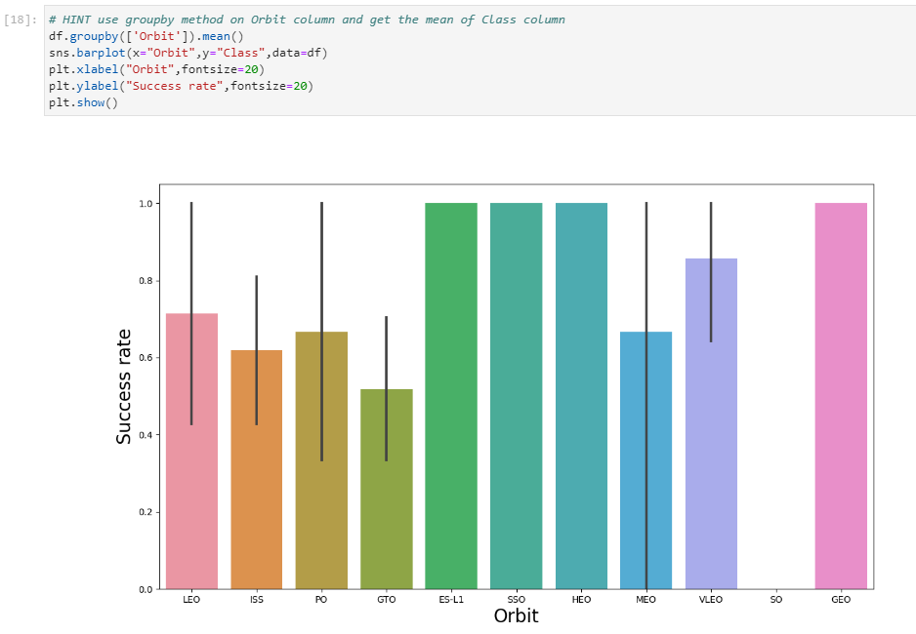
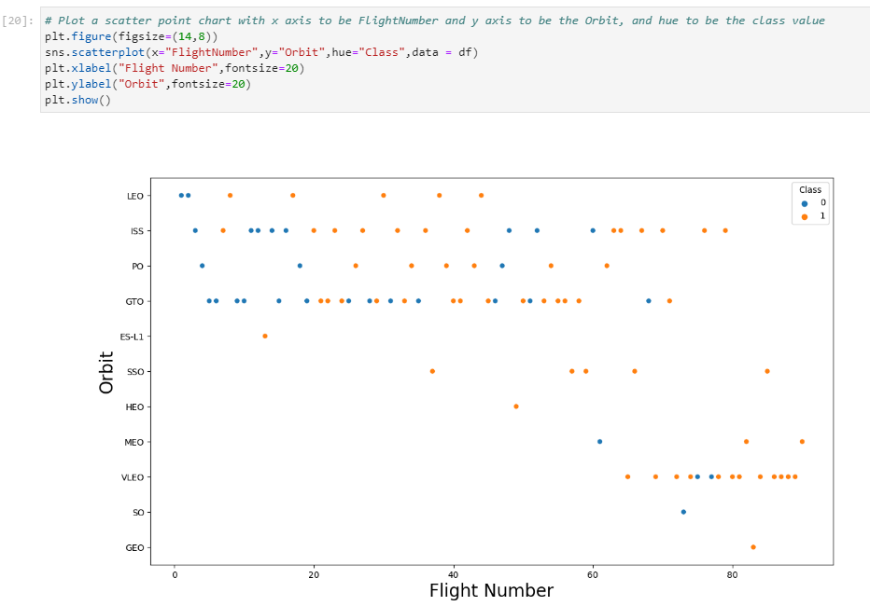
Results – Matplotlib and Seaborn
The relationship between success rate and orbit type
The relationship between flight number and orbit type

Slide 20
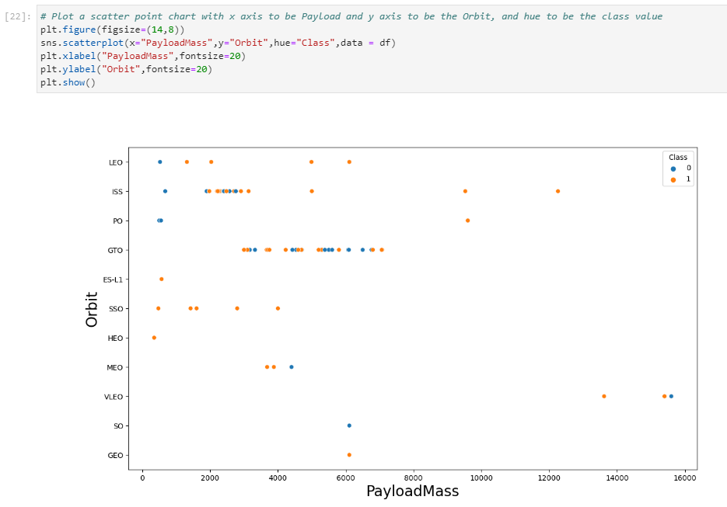
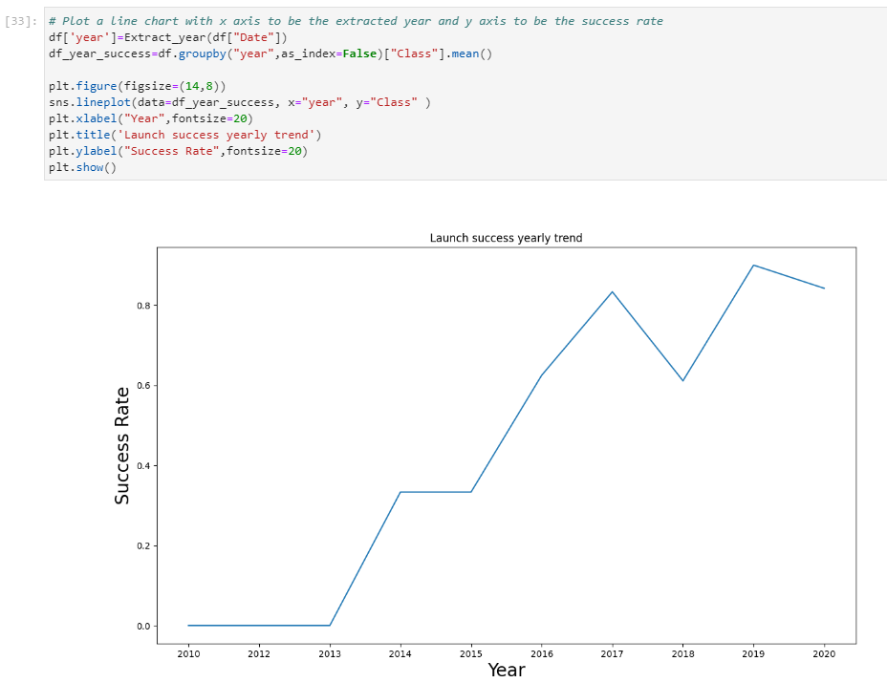
Results – Matplotlib and Seaborn
The relationship between payload mass and orbit type
The launch success yearly trend

Slide 21
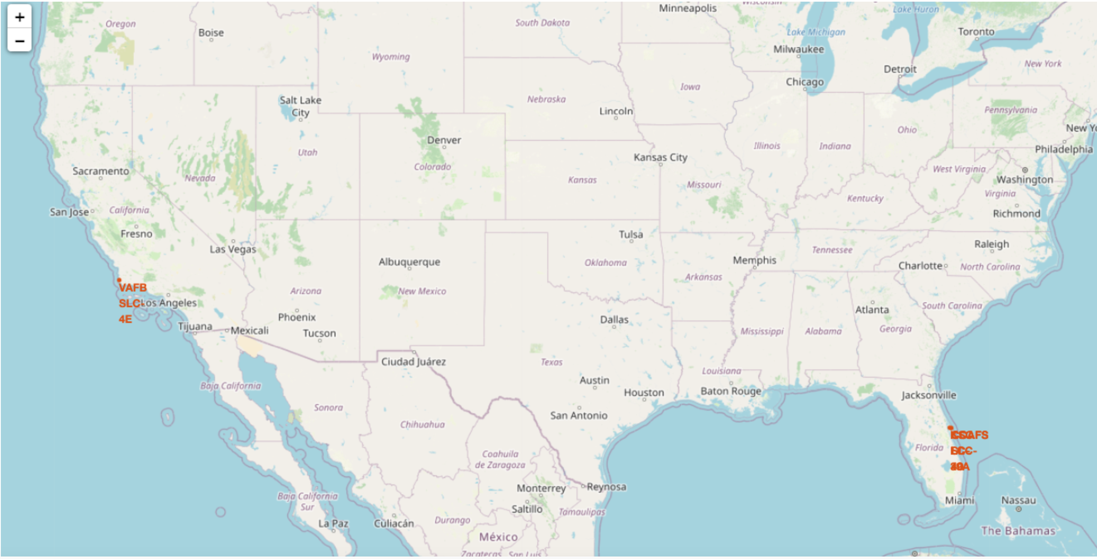
Results – Folium
All launch sites on map

Slide 22
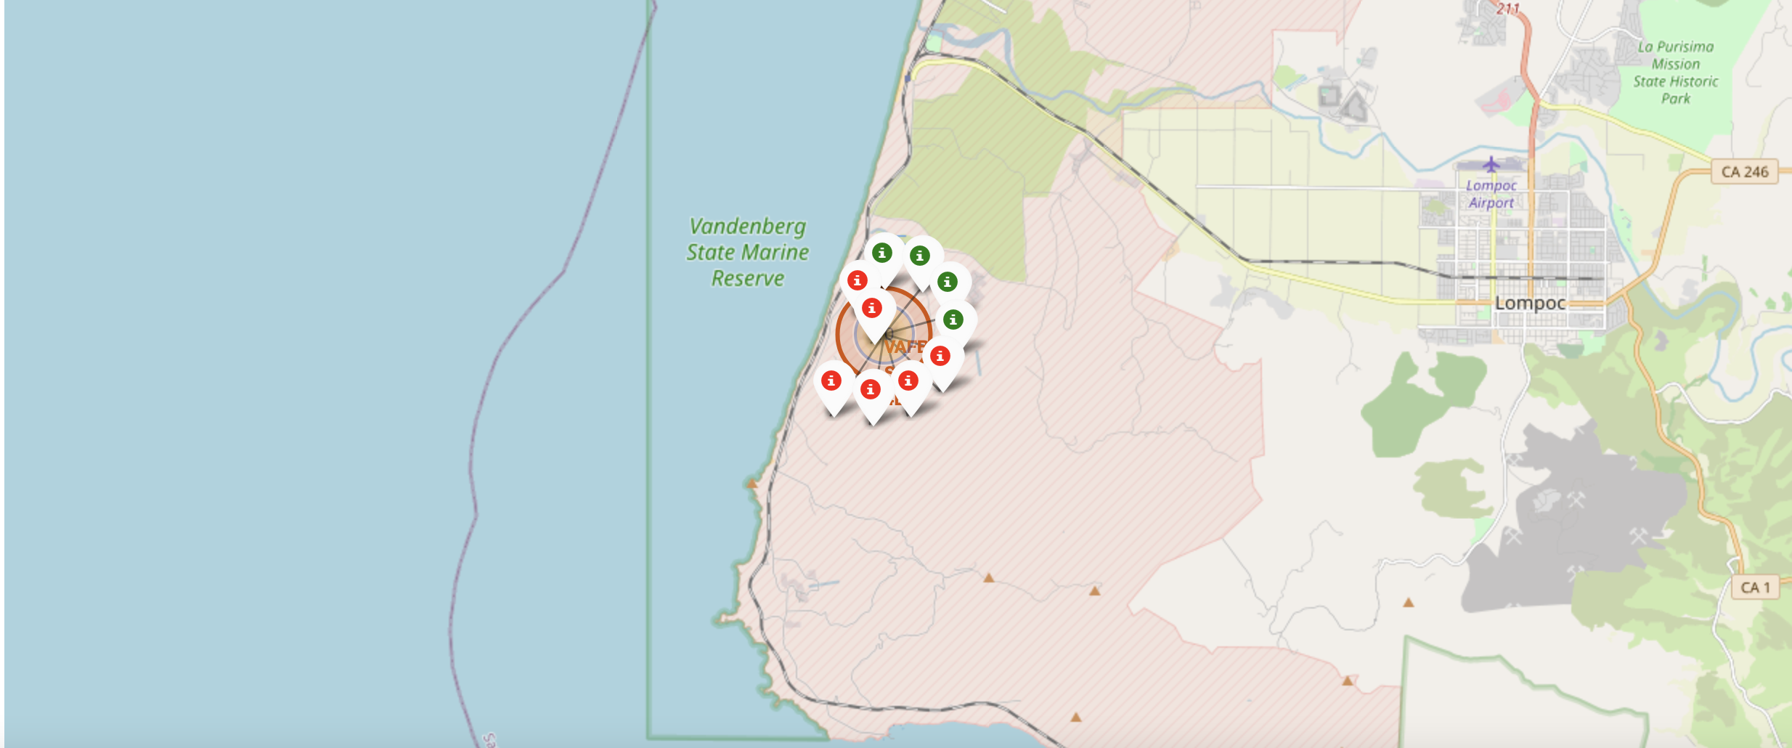
Results – Folium
The succeeded launches and failed launches for each site on map
If we zoom in on one of the launch site, we can see green and red tags. Each green tag represents a successful launch while each red tag represents a failed launch

Slide 23
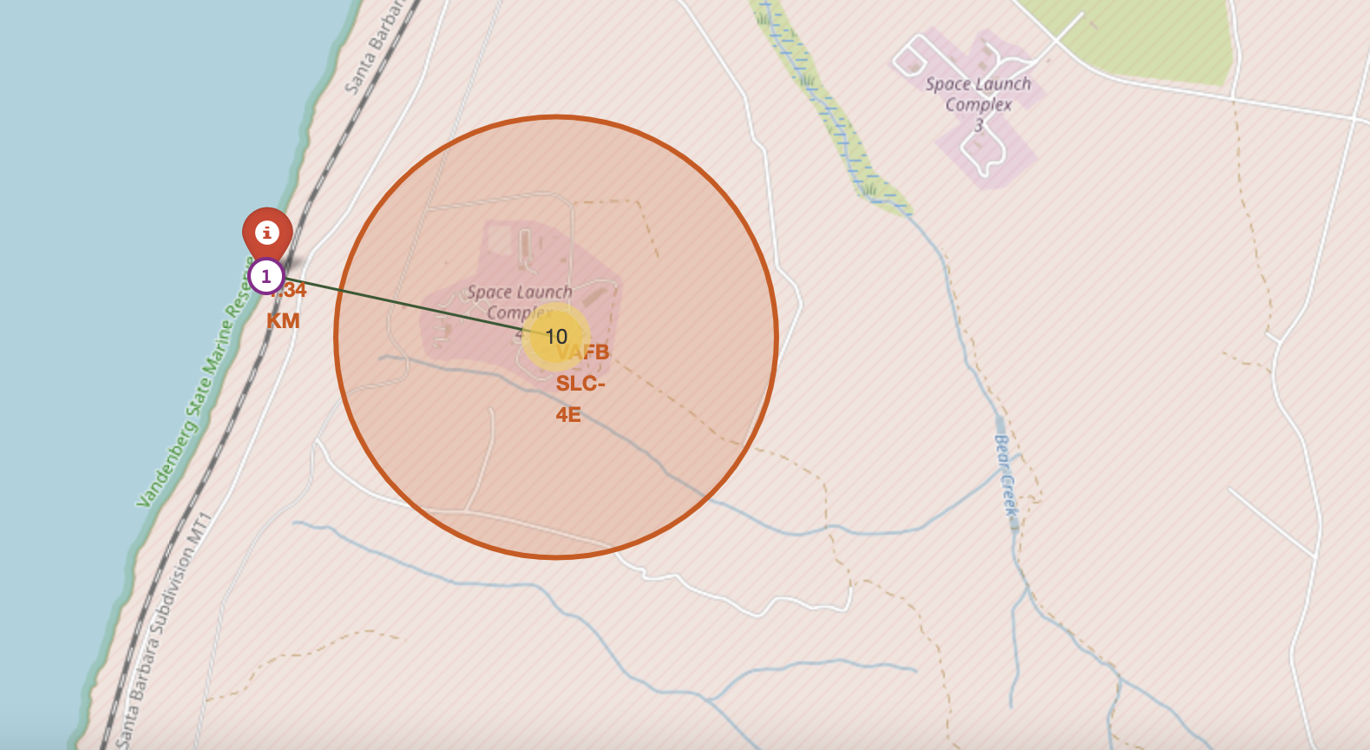
Results – Folium
The distances between a launch site to its proximities such as the nearest city, railway, or highway
The picture below shows the distance between the VAFB SLC-4E launch site and the nearest coastline

Slide 24
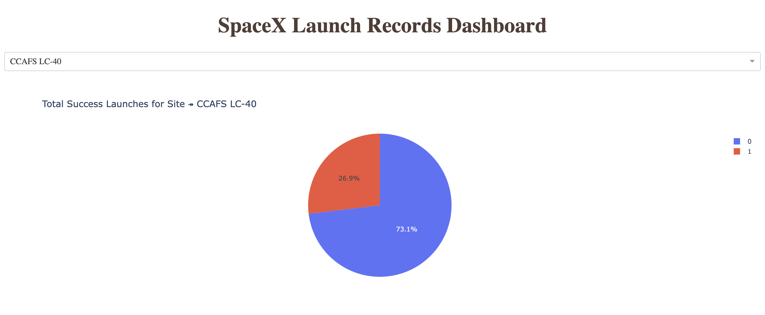
Results – Dash
The picture below shows a pie chart when launch site CCAFS LC-40 is chosen.
0 represents failed launches while 1 represents successful launches. We can see that 73.1% of launches done at CCAFS LC-40 are failed launches.

Slide 25
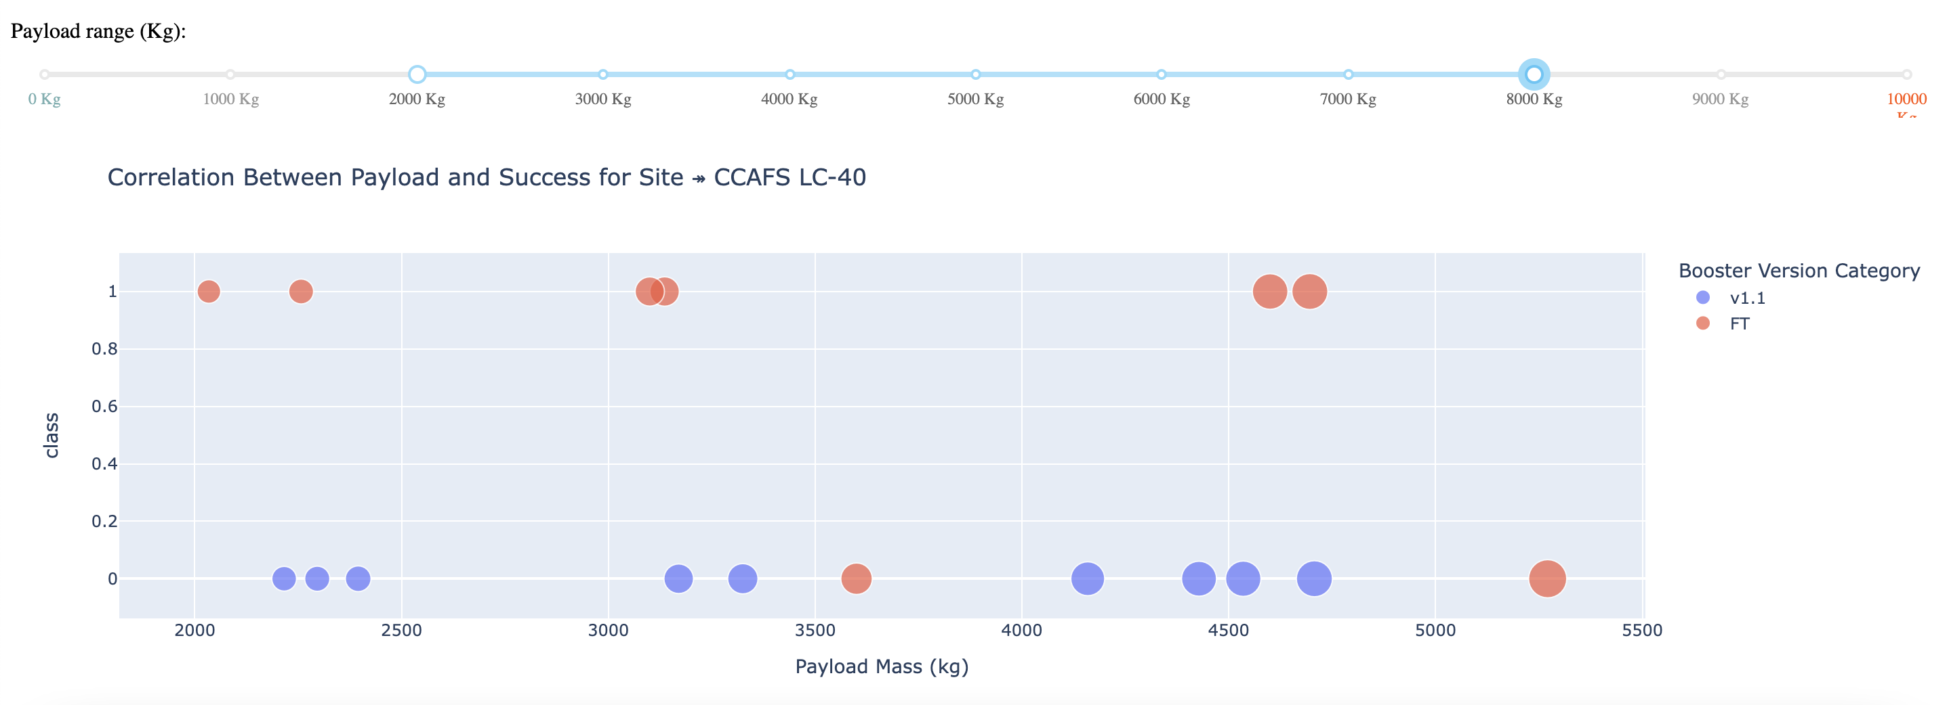
Results – Dash
The picture below shows a scatterplot when the payload mass range is set to be from 2000kg to 8000kg.
Class 0 represents failed launches while class 1 represents successful launches.

Slide 26
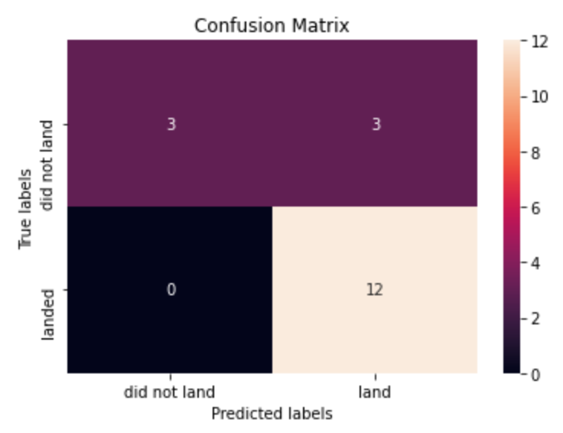
Results – Predictive Analysis
Logistic regression
GridSearchCV best score: 0.8465
Accuracy score on test set: 0.8334

Slide 27
Results – Predictive Analysis
Support vector machine (SVM)
GridSearchCV best score: 0.8483
Accuracy score on test set: 0.8334

Slide 28
Results – Predictive Analysis
Decision tree
GridSearchCV best score: 0.8893
Accuracy score on test set: 0.8334

Slide 29
Results – Predictive Analysis
K nearest neighbors (KNN)
GridSearchCV best score: 0.8483
Accuracy score on test set: 0.8334

Slide 30
Results – Predictive Analysis
Putting the results of all 4 models' side by side, we can see that they all share the same accuracy score and confusion matrix when tested on the test set.
Therefore, their GridSearchCV best scores are used to rank them instead. Based on the GridSearchCV best scores, the models are ranked in the following order with the first being the best and the last one being the worst:
Decision tree (GridSearchCV best score: 0.8892857)
K nearest neighbors, KNN (GridSearchCV best score: 0.8482142)
Support vector machine, SVM (GridSearchCV best score: 0.8482142)
Logistic regression (GridSearchCV best score: 0.8464285)

Slide 31
Discussion
From the data visualization section, it can be seen that some properties can be related to the task result in various ways.
For example, the rate of successful landing or positive landing with heavy payloads is greater for Polar, LEO and ISS orbit types. But for the GTO, it is not well distinguishable as both positive landing rate and negative landing are here.
Therefore, each feature can have a certain impact on the final task outcome. It is difficult to come up with precise ways of how each of these characteristics affects the task outcome.
However, some machine learning algorithms can be used to learn the pattern of historical data and predict whether a task will be successful based on the given features.

Slide 32
Results – Predictive Analysis
In this project, an attempt was made to predict whether the first stage of a given Falcon 9 launch would land in order to determine the cost of a launch.
Each aspect of a Falcon 9 launch, such as payload mass or orbit type, can affect mission outcome in a particular way.
Various machine learning algorithms are used to learn patterns from past Falcon 9 launch data to produce predictive models that can be used to predict the outcome of a Falcon 9 launch.
The prediction model produced by the decision tree algorithm showed the best performance among the 4 machine learning algorithms used.

